Slide 1
Applied Data Science Logistic Regression
Dr. Omri Allouche
2017

Slide 2
Refresher
Watch Week 3 of Andrew Ng’s https://www.coursera.org/learn/machine-learning

Slide 3
Logistic regression
Despite the name, is used for Classification, not Regression.
Can be extended to multiclass classification.

Slide 4
Odds Ratio

Slide 5


Logistic Function
Sigmoid function
Inverse of the Logit function

Slide 6
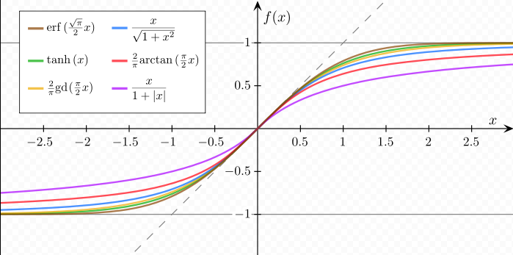
Sigmoid Functions
Notes:
all functions are normalized in such a way that their slope at the origin is 1.

Slide 7
Handling Multiple Classes
One vs. Rest (SciKit Learn’s OneVsRestClassifier)
One vs. One (SciKit Learn’s OneVsOneClassifier)

